Slide 1
1

Slide 2
Oral Health and Hygiene
Dr. Shally Mahajan
MDS, Orthodontics and Laser Specialist
Professor and Head, Department of Dentistry
Dr. RMLIMS, Lucknow
2

Slide 3
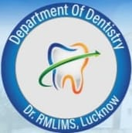
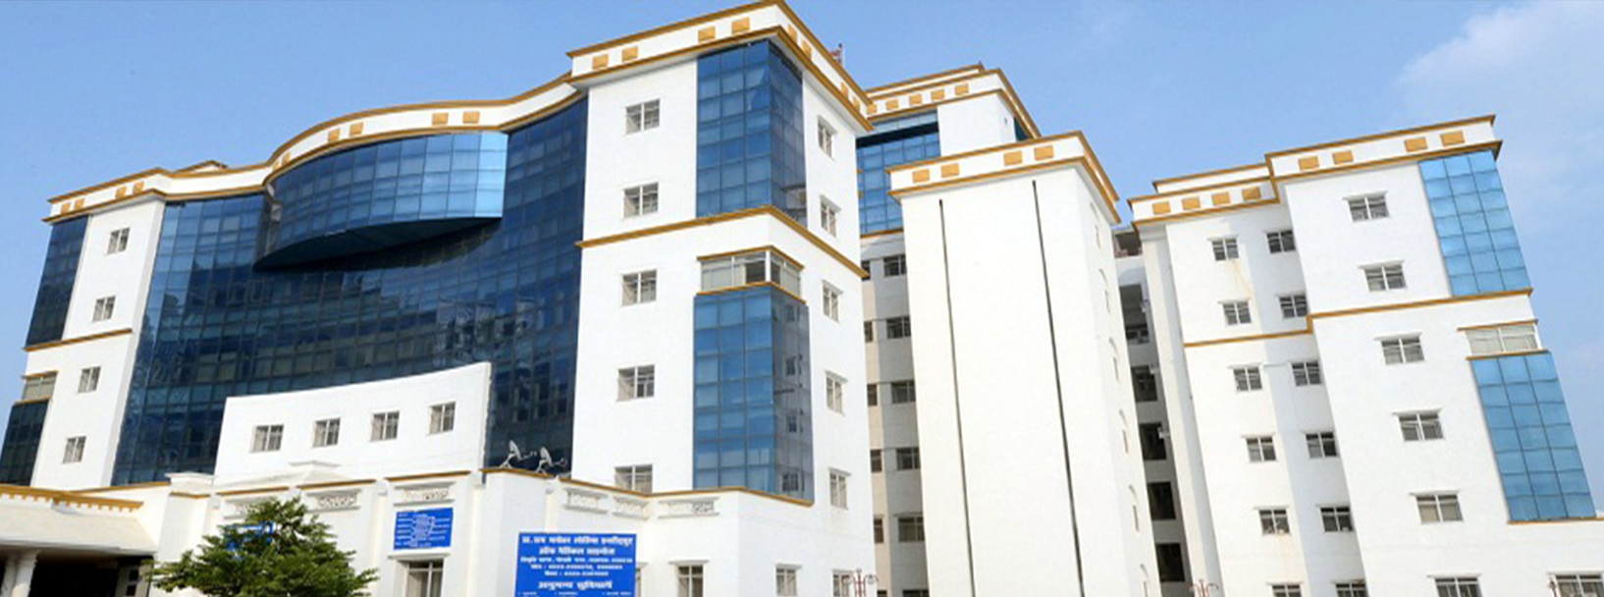
DR. RAM MANOHAR LOHIA INSTITUTE OF MEDICAL SCIENCES, LUCKNOW
DEPARTMENT OF DENTISTRY
3

Slide 4
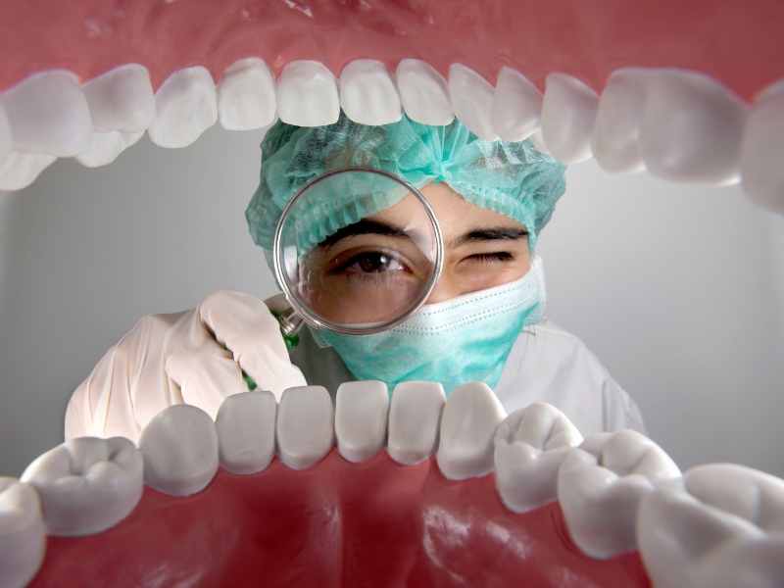
Introduction
Oral health is an important aspect of health, physical and mental well-being.
It affects not only the individual, but also the broader health system and economy.
According to the Global Burden of Disease Study 2016 half of the world’s population (3.58 billion people) are estimated to be affected by oral diseases.
4
Notes:
India is very rich culturally

Slide 5
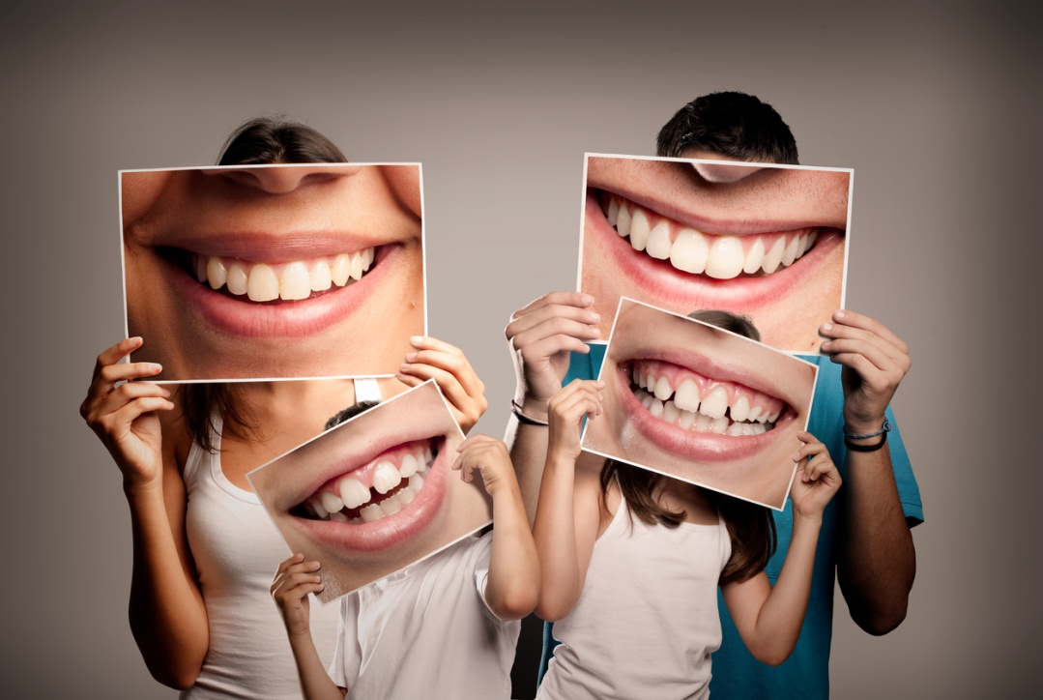
Significance of Oral Health
Impacts chewing, taste, swallowing, digestion, smile, speech, facial expressions and confidence
Affects nutrition and quality of life
Poor health is linked to systemic conditions
Regular dental care promotes oral health, preventing dental problems and supporting overall health and confidence
5

Slide 6
Conditions can be linked to oral hygiene
Endocarditis
Pneumonia
Cardiovascular disease
HIV
Osteoporosis
Diabetes
Mouth Body Connection
Approx. 90% of systemic disease have links to oral health
6

Slide 7
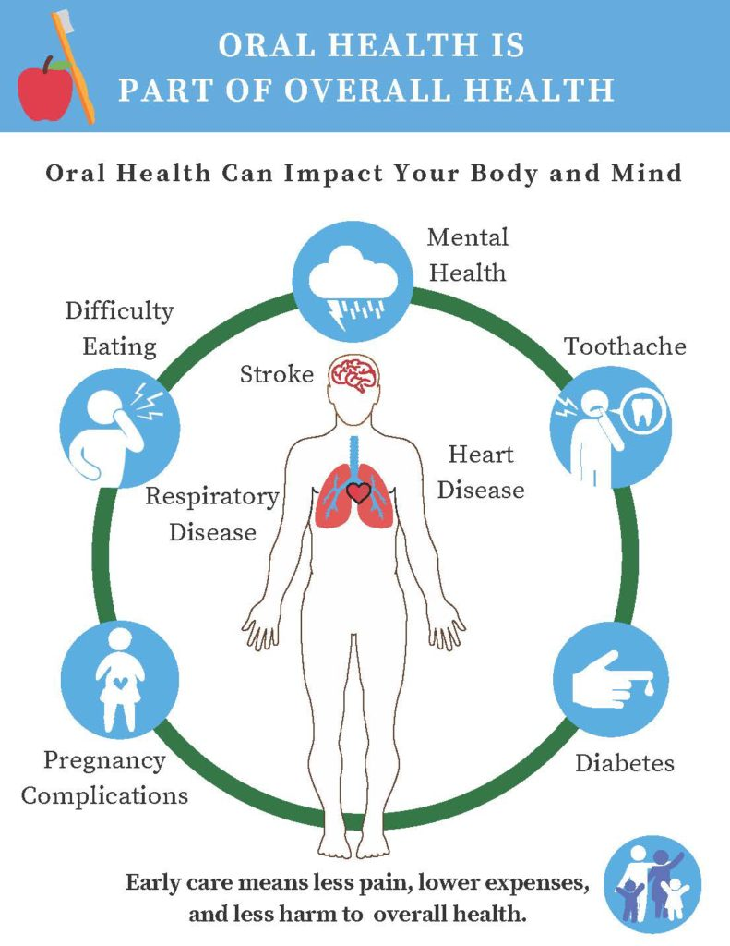
7

Slide 8
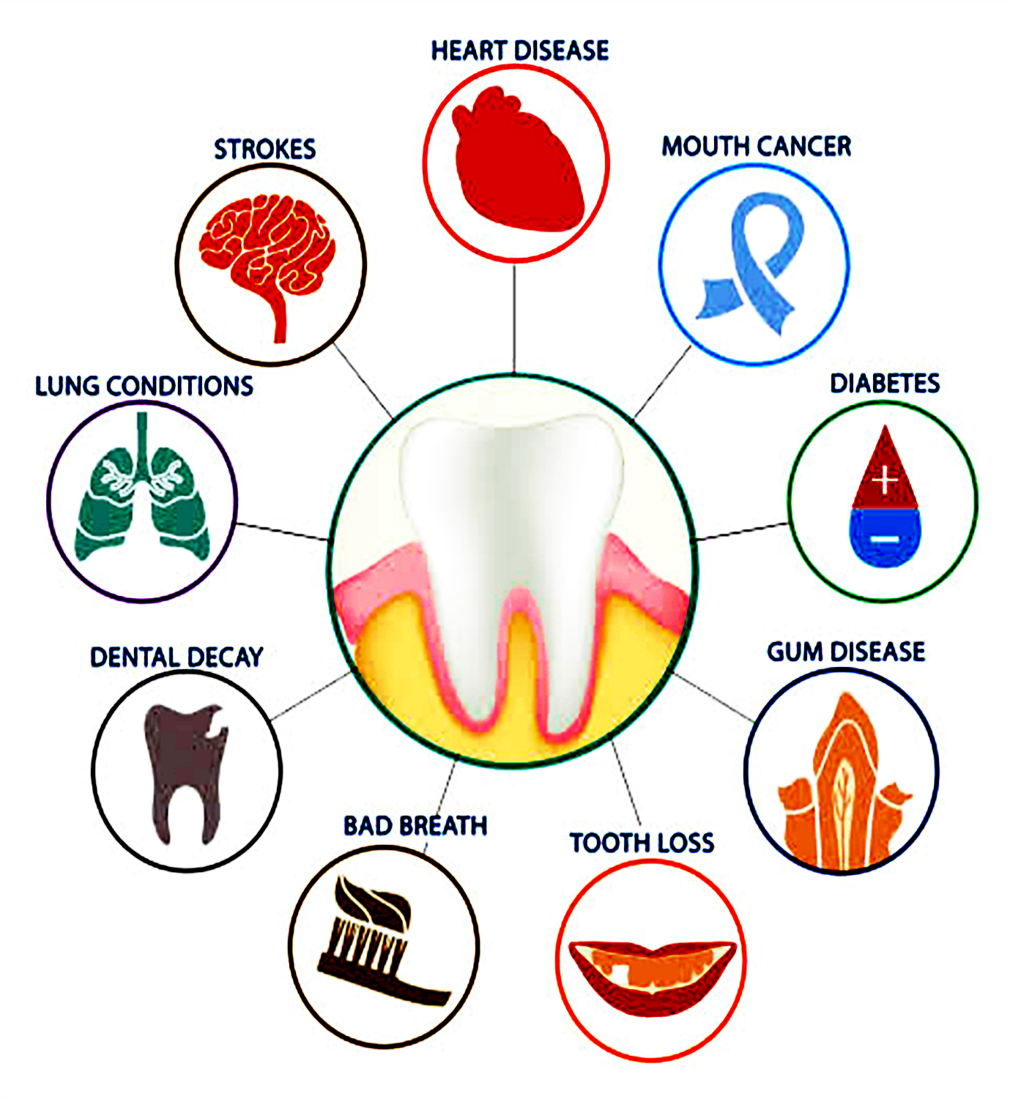
What Problems Could Poor Dental Health Cause?
40-45% of population have dental caries, often leading to pain and discomfort.
More than 90% of the population have periodontal diseases.
People having periodontal disease have double risk of heart attack
Infection in oral cavity increase risk of respiratory infection
19-32% of population aged more than 65 years is edentulous while 12.6 per one lakh population have oral cancer.
Diabetes with periodontal disease have more difficulty of controlling blood sugar level.
8

Slide 9
Types of Teeth
9

Slide 10
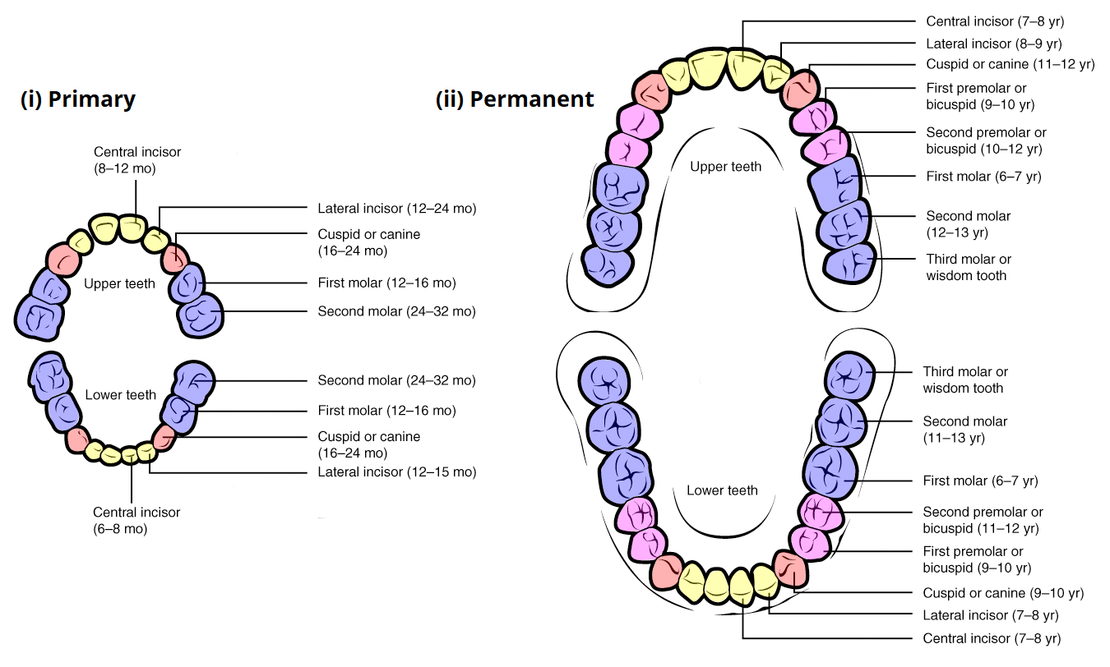
Types of Dentition
10

Slide 11
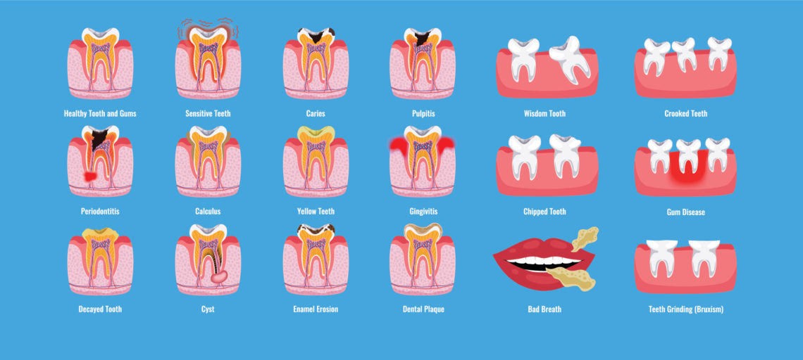
Common Oral Health Problems
11

Slide 12
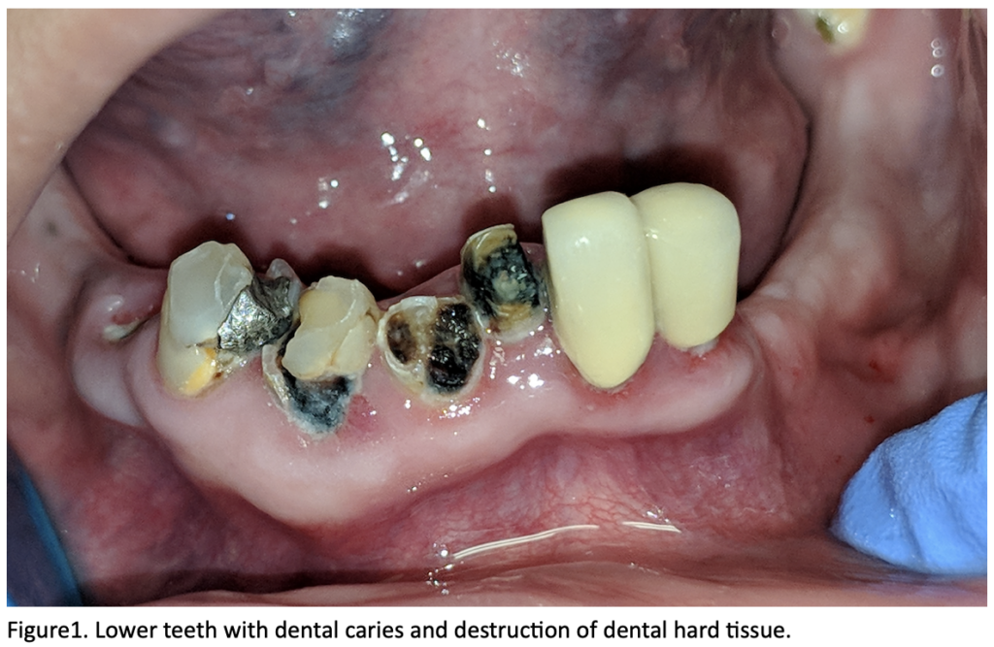
Dental Caries
A Global Health Burden and the Cost of Neglect
According to the World Health Organization (WHO), around 2.3 billion people worldwide suffer from dental caries in permanent teeth, making it one of the most prevalent chronic diseases.
12

Slide 13
Poor oral hygiene
Sweet sticky foods
Bad or worn out fillings
Dry mouth
Crowding of teeth
13

Slide 14
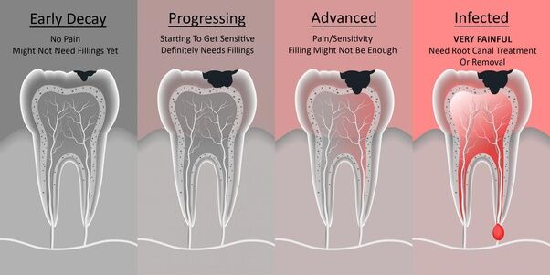
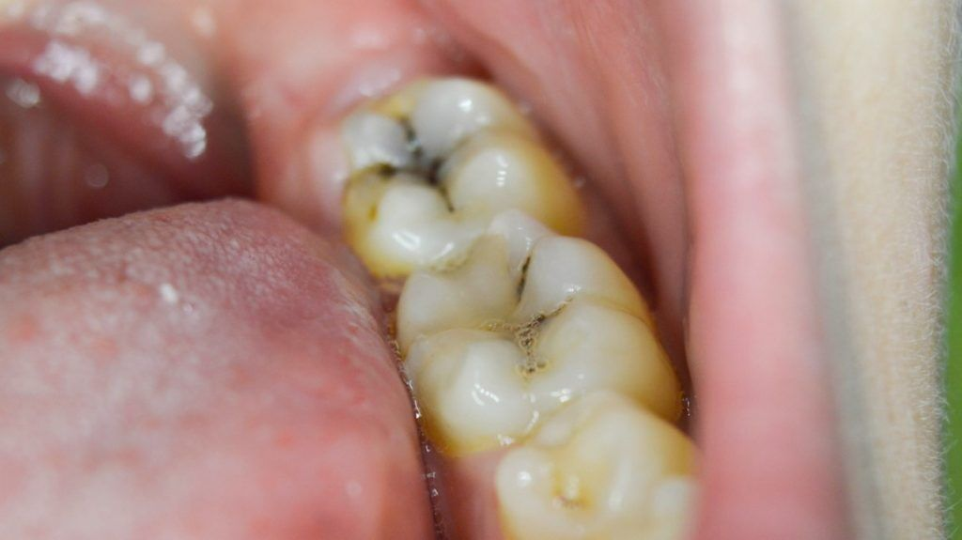
It only takes about 4 to 12 hours for the bacteria to use the starch and sugar and build an invisible and sticky biofilm around your teeth called plaque.
Due to poor oral hygiene, the bacteria in the plaque produce acids that remove minerals from your tooth enamel.
The constant release of acids will weaken your tooth enamel until it opens up and gets infiltrated by the bacteria.
Demineralization
Breakdown of tooth enamel
Dentin damage
Pulp decay
Tooth abscess
Progression of a Dental Cavity
14

Slide 15
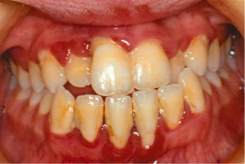
Gingivitis
Inflammation of gingival tissue
Primarily due to plaque build up and its effects are completely reversible with improved oral hygiene.
Bleeding gums
Hormonal
Drug induced
15

Slide 16
Periodontitis
Affects 3 out of 4 people
Cause 70% tooth loss
Infected gum recedes
Plaque and calculus ++ continues to increase gingivitis has been left untreated and the condition has progressed to an irreversible state.
Pockets become infected
Characteristically involves bone loss from around select teeth, and can present either localised or generalised
16

Slide 17
Additional contributors
Genetics
Auto-immune diseases
Low saliva flow
Some medications
Stress, leading to acidity in the mouth
Chronic inflammation
Smoking
Acid Reflux
Viral infections
17

Slide 18
Additional contributors are:
Gum inflammation
Bleeding-prone mucous membranes Plaque, Calculus
In more severe cases, even dental displacement might develop, as well as pathological dental migration.
Some risk factors triggering periodontitis include passive tobacco consumption, diabetes, CD4+ T lymphocyte count <200 cells/μL, and xerostomia
18

Slide 19
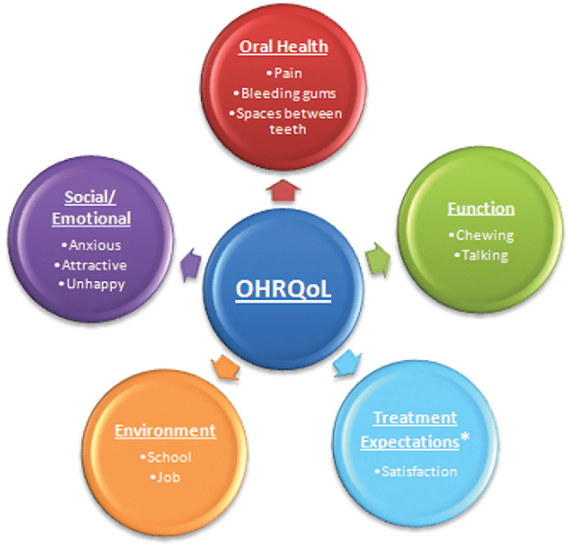
Oral Health Relation on Quality of Life
Oral health significantly influences daily life, affecting eating, speaking, and social interactions.
Poor oral health can lead to pain, discomfort, and self-consciousness, impairing quality of life.
Conversely, maintaining good oral hygiene promotes confidence, comfort, and overall well-being, enhancing one's ability to enjoy life to the fullest.
19

Slide 20
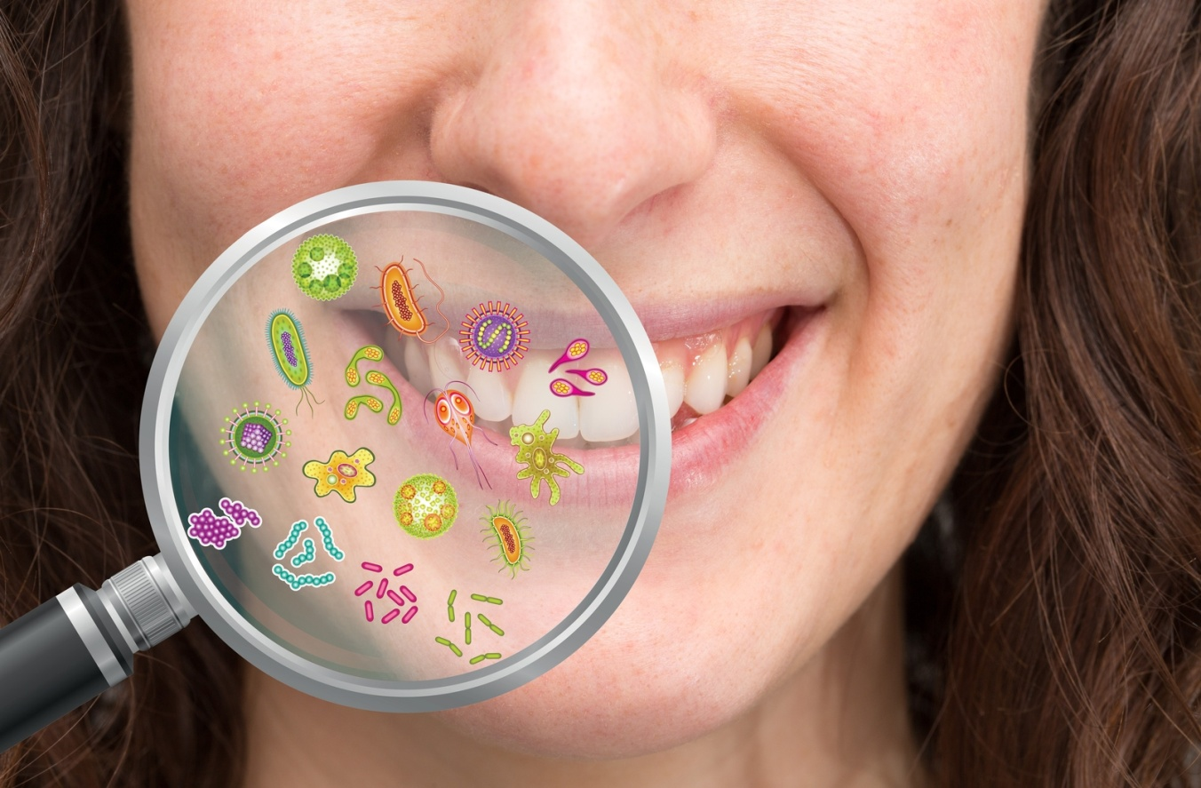
Oral Manifestations of Systemic Diseases
Often serve as early indicators of underlying health issues
Various systemic conditions can present with oral symptoms, ranging from mild discomfort to severe pathology.
Recognizing these oral manifestations is crucial for early detection, prompt treatment, and better management of systemic diseases.
Additionally, implementing preventive measures can help mitigate the risk of oral complications associated with systemic conditions.
20

Slide 21
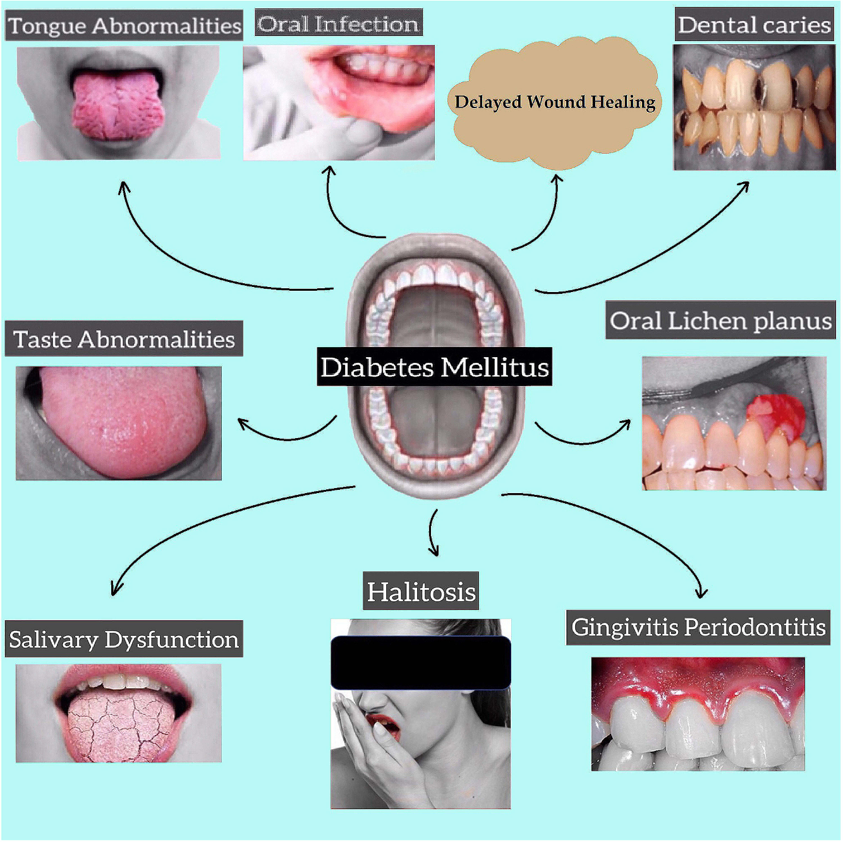
Diabetes Mellitus
Metabolic disorder characterized by elevated blood sugar levels.
Oral manifestations of diabetes include gingivitis, periodontitis, xerostomia (dry mouth), and oral candidiasis (oral thrush).
Poorly controlled diabetes can exacerbate these oral conditions, leading to increased risk of tooth loss and delayed wound healing in the oral cavity.
21

Slide 22
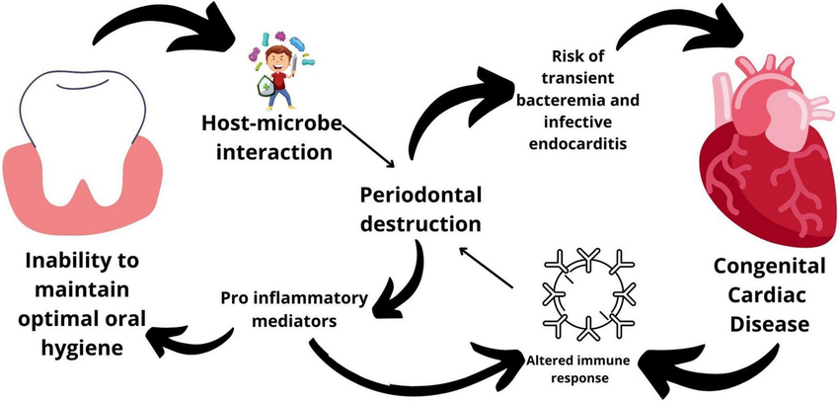
Cardiovascular Disease
Several studies have linked periodontal disease, a chronic inflammatory condition of the gums, to an increased risk of cardiovascular disease.
Oral bacteria from periodontal infections can enter the bloodstream, contributing to the development of atherosclerosis and increasing the risk of heart attacks and strokes.
Maintaining good oral hygiene and treating periodontal disease promptly can help reduce this risk.
22

Slide 23
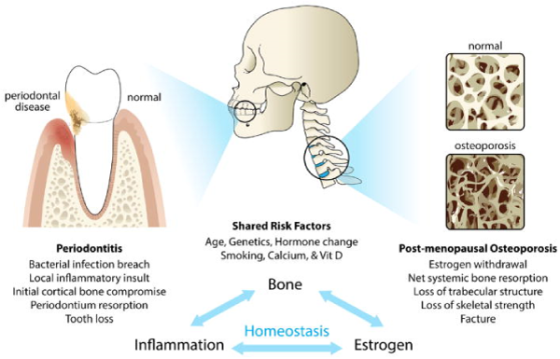
Osteoporosis
Systemic condition characterized by decreased bone density and increased risk of fractures.
In the oral cavity, osteoporosis may manifest as bone loss in the jaw, leading to tooth mobility and eventual tooth loss.
Regular dental check-ups, along with a diet rich in calcium and vitamin D, can help prevent and manage oral complications associated with osteoporosis.
23

Slide 24
HIV/AIDS
Various oral manifestations
Oral Candidiasis
Oral Hairy Leukoplakia
Periodontal Disease.
These oral conditions can compromise oral health and quality of life for patients with HIV/AIDS.
24

Slide 25
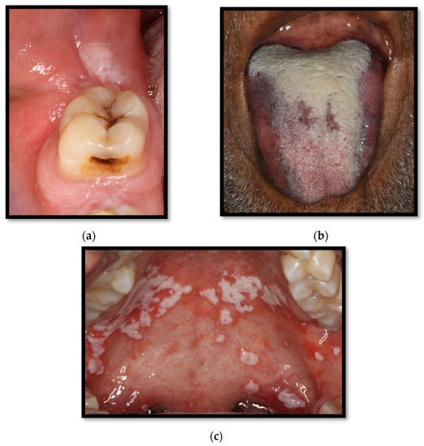
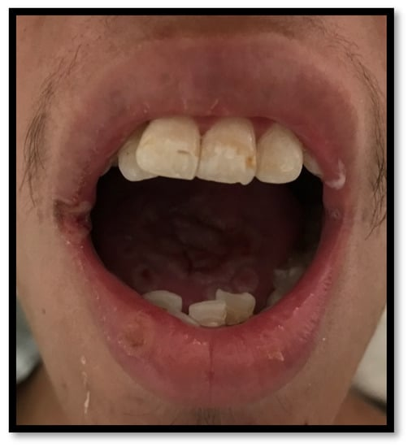
Oral Candidiasis / Oral Thrush
Most common oral lesion in HIV/AIDS-infected patients, with a wide prevalence range, starting from 17% up to 75%
The risk factors predisposing oral thrush development are the CD4+ T lymphocyte count <200 cells/μL, tobacco use, and wide spectrum antibiotic use or corticosteroids, which result in oral dysbiosis
Other local conditions
Using partially removable dentures, which create a substantially acidic, moist, and anaerobic environment, increasing mucous membrane permeability, which favors the pathogen’s colonization capability
Decreased quality and quantity of saliva → Candida infection
Malnutrition, malabsorption, or a deficient diet, particularly hematinic deficiencies (such as iron, vitamin B12, and folic acid), which are factors that might predispose oral candidiasis via mucous membrane compromise.
25

Slide 26
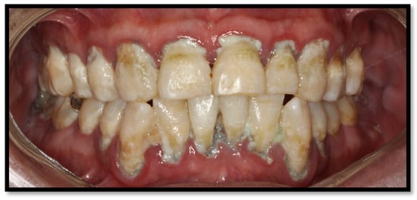
Necrotizing Gingivitis (NG) Necrotizing Periodontitis (NP)
Localized or generalized
Acute and severe adjacent alveolar destruction, as well as spontaneous bleeding and deep, intense pain
The loss of the alveolar ridge is related to marginal necrosis, meaning that periodontal pouch formation is unlikely.
On the other hand, exposed alveolar and interseptal bones are common.
26

Slide 27
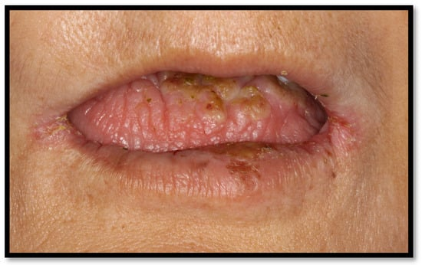
Xerostomia
Xerostomia is also associated with the consumption of some drugs- antidepressants, RT, Antihypertensives, diuretics, anxiolytics, oral antidiabetic agents (mainly sulfonylureas), respiratory agents, quinine, antihypertensives (such as thiazides and calcium channel blockers), urinary anti-spasm agents, glucosamine, NSAIDs, opioids, ophthalmologic drugs, and magnesium hydroxide.
Saliva-scarce mouth floor, together with erythematous dry oral mucosal membranes and tongue, which might come along with fissures.
This ailment might develop together with a swallowing and/or speaking impairment and a low spicy, sour, and crunchy flavor threshold.
Additionally, patients complaining of taste distortion or trouble using dentures are common.
Salivation impairment has been considered a risk factor for developing caries, as well as increasing the risk of oral infection, such as candidiasis and periodontal disease.
It might also favor mucositis, tongue fissures, dysgeusia, speech difficulties, halitosis, oral irritation, chewing and swallowing trouble, and even weight loss and cachexia.
27

Slide 28
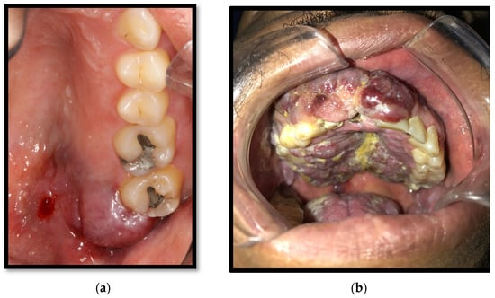
Kaposi’s Sarcoma
Most common oral HIV-associated neoplasia, appearing in up to 6% of patients, and has been notably decreasing due to the use of ART
This endothelial angioproliferative neoplasia is caused by human herpesvirus 8
Its pathological features might oscillate according to the location of the lesions (ganglia, mucous membranes, or skin) as well as its morphological stage (patch, plaque, and nodule), progressing from papules, which convalesce into red-purplish plaques, which might ulcer and cause nearby tissue destruction.
The early lesions are usually flat, red, and asymptomatic but usually develops a darker color with convergent wounds.
In advanced stages, the lesion might appear as multiple firm purple nodules, which might disturb normal mouth function and cause symptoms owing to trauma or infection.
The ulceration and local destruction of this entity lead to the extraction of some dental organs in some cases.
It predominantly appears on the hard palate, major salivary glands, and jawbone.
28

Slide 29
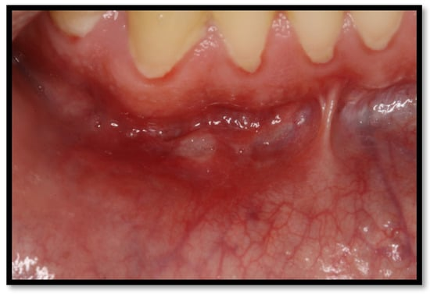
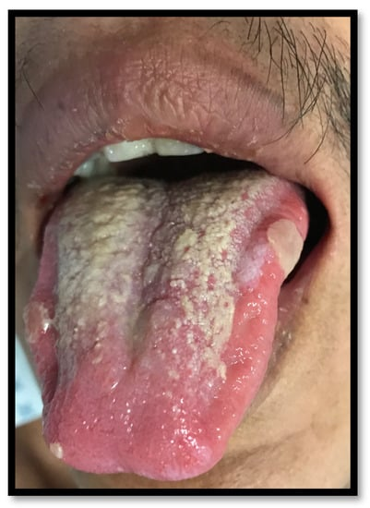
Recurrent Major and Minor Aphthous Ulcers
Frequent painful erythematous halo, coated with a yellow-grayish pseudomembrane, with a diameter ranging from 2 to 5 mm to major apthous ulcers 1-5 cm in diameter.
Non-keratinized oral mucous membrane, typically lingering from 7 to 10 days, healing later without any scarring
Lateral border of tongue, soft palate, mouth floor, oral mucous membranes, and oropharynx (including both keratinized and non-keratinized mucosal surfaces)
Remarkably painful, particularly while consuming salty, spicy, sour, and hard or rough foods and beverages. They may last up to weeks, causing dysphagia, trouble speaking and chewing, developing an induration on their borders, and leaving retractile fibrous scars after healing.
29

Slide 30
Oral health in Pregnancy
Dental health may be considered an important component of prenatal care.
During pregnancy, poor oral health can result in poor health outcomes for the mother and baby
More prone to gingivitis, periodontal disease and cavities.
30
Notes:
India is very rich culturally

Slide 31
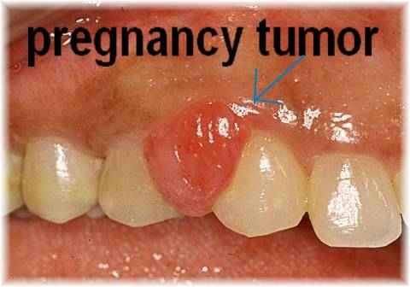
Oral health in Pregnancy
Birth Defects And Gum Disease
Gingivitis, affects between 60 to 75 percent of pregnant women
Manifests as red, swollen gums from inflammation that may be compounded by shifting hormones during pregnancy.
Untreated gingivitis may progress to periodontitis, and teeth may eventually become loose and require extraction.
Poor pregnancy outcomes, includes birth defects, preterm birth and low birth weight, have also been linked to periodontitis.
31
Notes:
India is very rich culturally

Slide 32
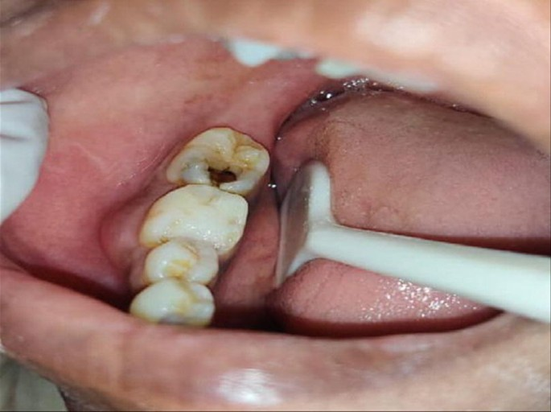
Oral health in Pregnancy
Dental Cavities And Pregnancy
One out of every four women of childbearing age suffers from untreated cavities.
During pregnancy due to changes in behavior, such as eating habits, pregnant women may also be more susceptible to cavities.
More than three times as likely to develop cavities
32
Notes:
India is very rich culturally

Slide 33
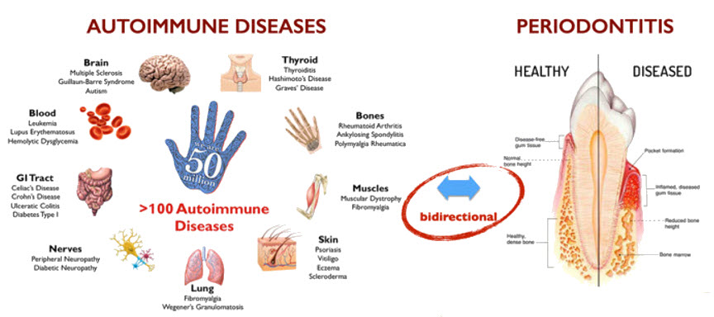
Autoimmune Diseases
>100 different autoimmune diseases.
Oral signs are frequently the first manifestation of autoimmune diseases.
Many autoimmune conditions result in a decrease in saliva if the immune system attacks the salivary glands.
Can affect oral health by causing dry mouth, oral ulcers, and gingival inflammation.
Disease Affect
Saliva
Mouth
Swallowing
Patients with autoimmune diseases may require special oral hygiene regimens and saliva substitutes to alleviate symptoms and maintain oral health.
33

Slide 34
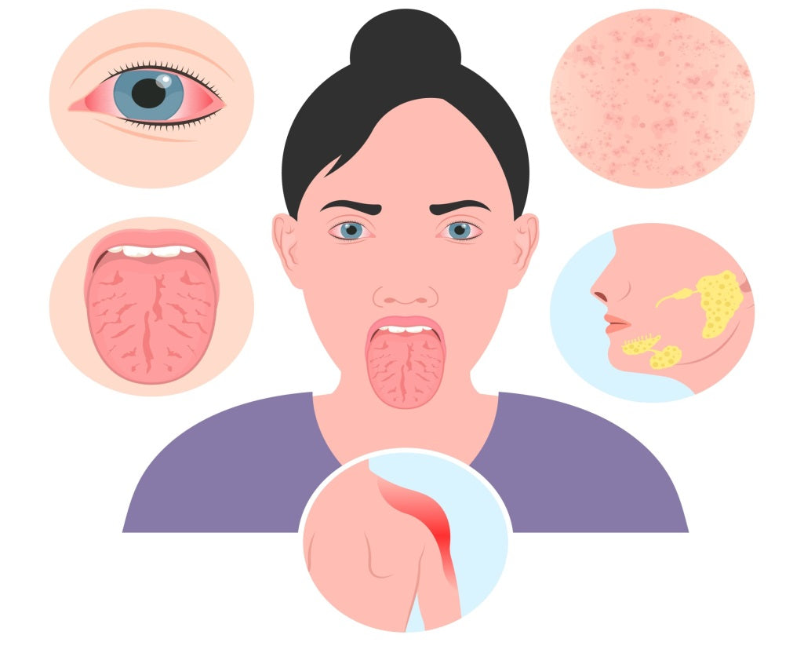
Disease That Affects Saliva
Sjögren's syndrome is the second most common autoimmune disease.
About 90 percent of the patients are women, and approximately 3 percent of all women over age 50 are affected by the disease.
Some instances of Sjögren's syndrome are associated with dry eyes, dry mouth and rheumatoid arthritis.
This disease attacks the glands
Saliva is thicker in consistency and people afflicted with the disease may experience trouble eating and swallowing.
Both of these symptoms disturb taste and speech and cause an increase in dental cavities.
Cobblestone-like appearance of tongue.
Often get a fungal infection, called candidiasis.
Good oral hygiene and frequent dental visits are needed to minimize the effects of this disease.
34

Slide 35
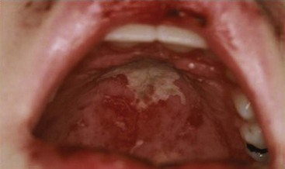
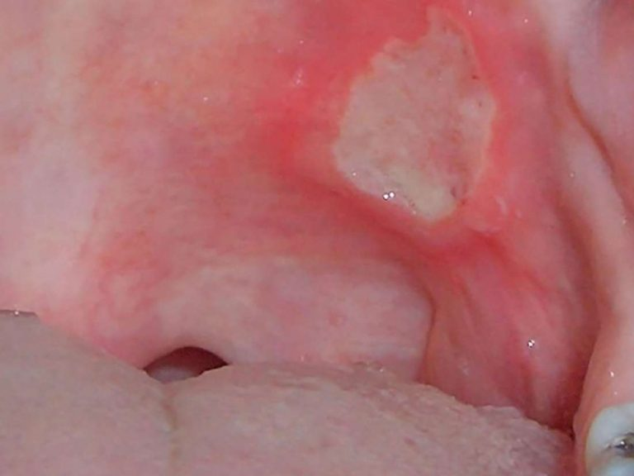
Diseases That Affect the Mouth
Systemic lupus erythematosus seen mostly in young women damages body parts including skin, joints and kidneys. This disease causes fever, weight loss and a butterfly rash across the nose and cheeks. The oral manifestation that is most significant is mouth ulcers; the sores may not cause the patient pain.
Crohn’s disease involves the entire GI tract.
Usually occurs in the patient's 20's and 30's but may also occur later in life in the 60s and 70s
Affects the oral cavity in 8 to 29 percent of the patients who have this disease.
Oral symptoms include swelling of the gums, ulcers in the mouth and swelling of the lips. These symptoms can cause eating difficulty and may be among the first of the disease's symptoms to appear.
35

Slide 36
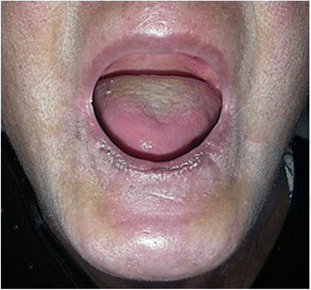
Diseases That Affect Swallowing
Hashimoto's disease is an inflammation of the thyroid.
This disease can cause facial swelling, weakness, fatigue and sensitivity to cold. The throat may swell to such a degree that patients have difficulty swallowing.
Scleroderma causes abnormal growth of connective tissue in the skin and blood vessels and can lead to organ failure. The disease can cause skin to become thick or cause facial skin to become extremely tight. People with this disease may have trouble swallowing.
36

Slide 37
How to know whether you have a cavity?
Food gets stuck between teeth
Bad breath
Tooth Ache
Sensitivity
37

Slide 38
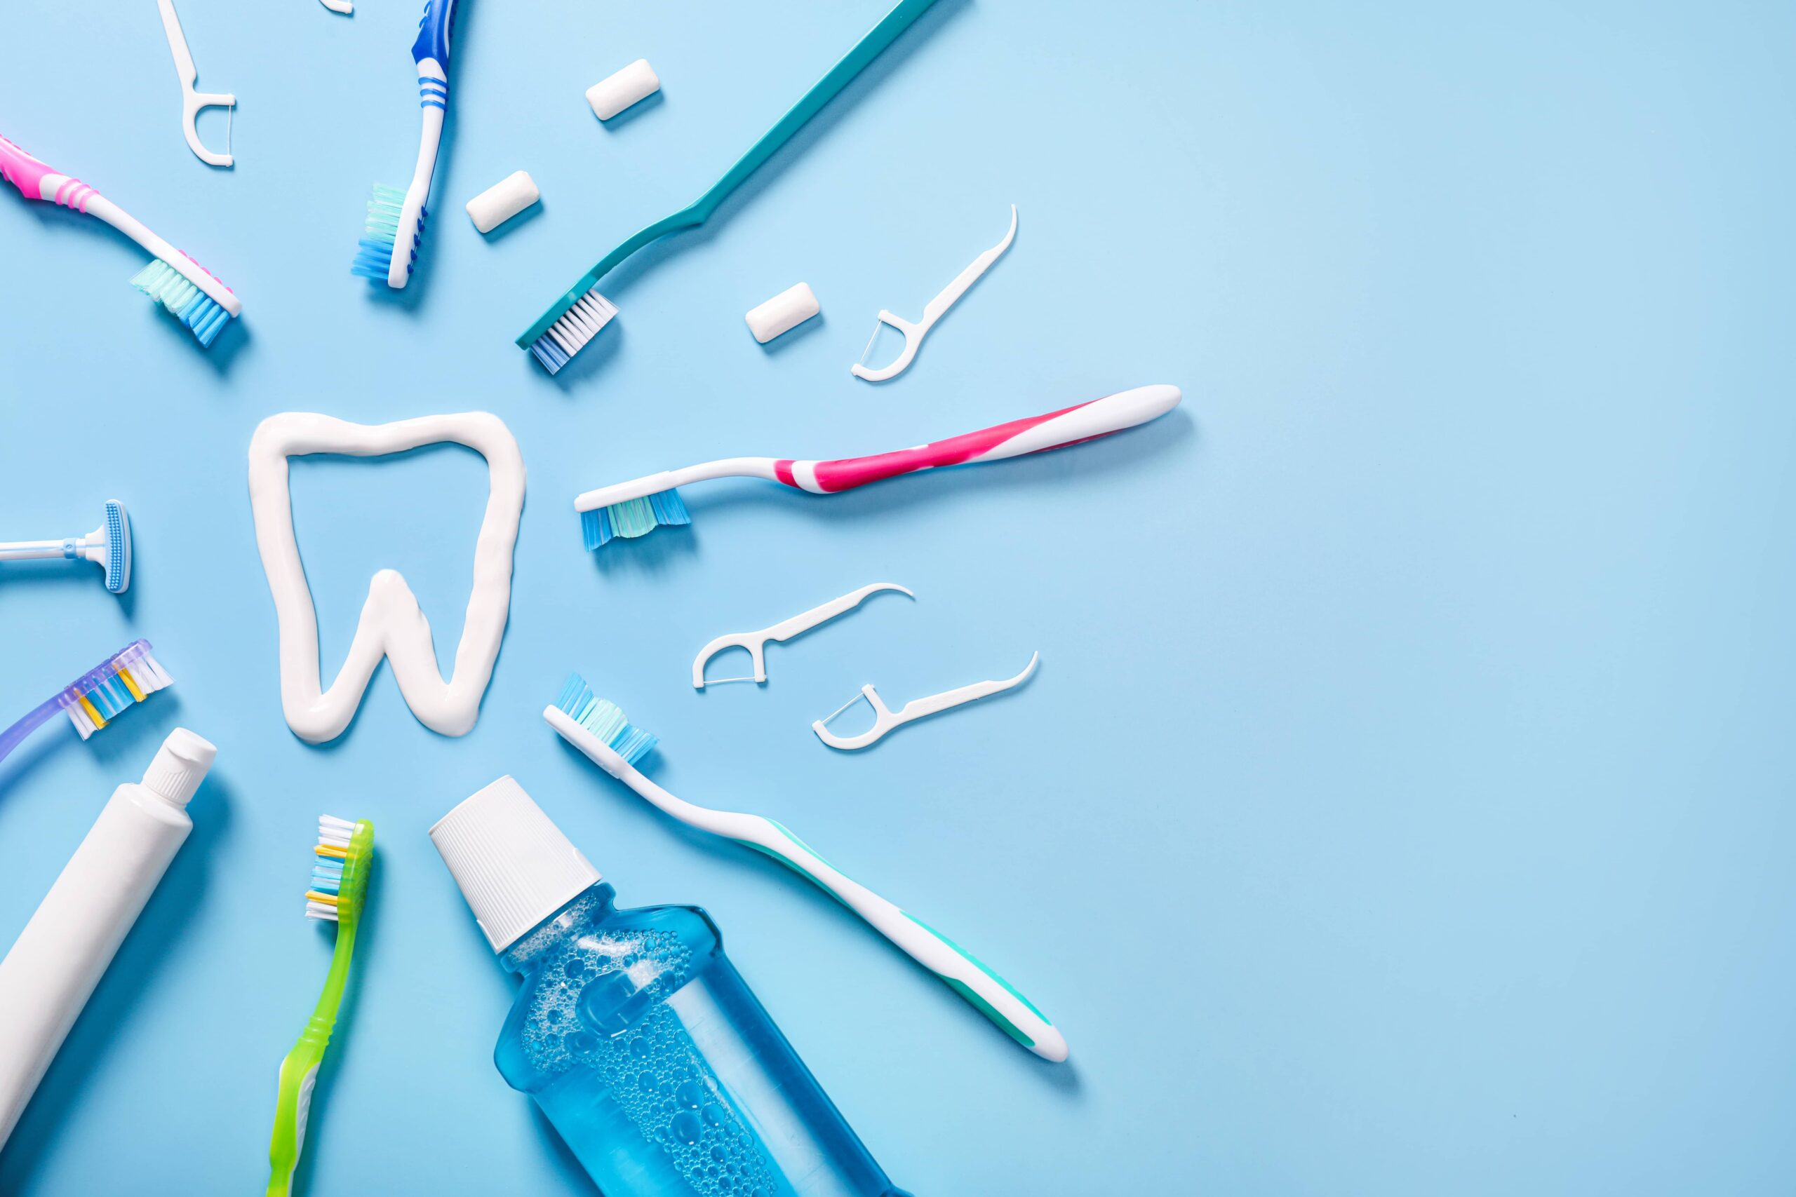
To Maintain Oral Hygiene
38

Slide 39
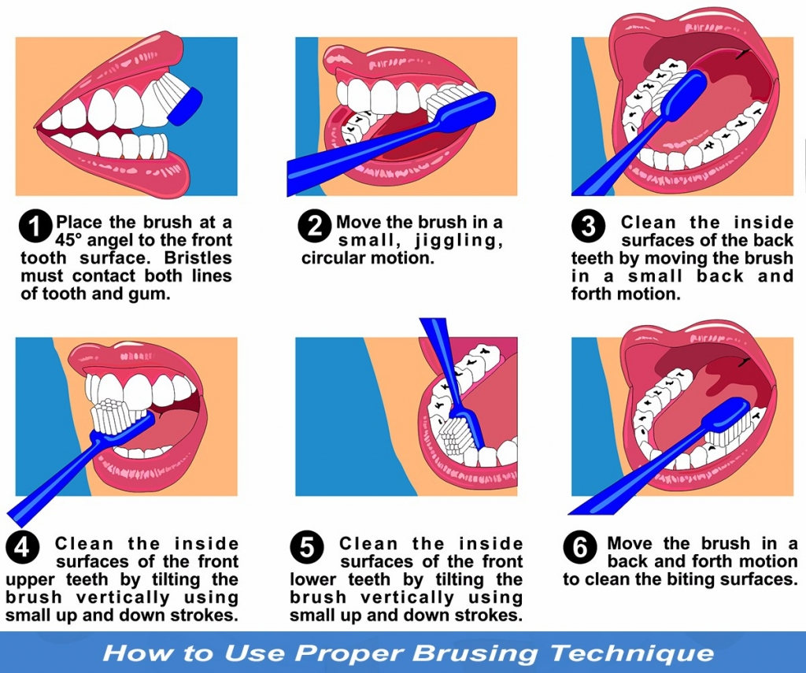
Proper Brushing Technique
39

Slide 40
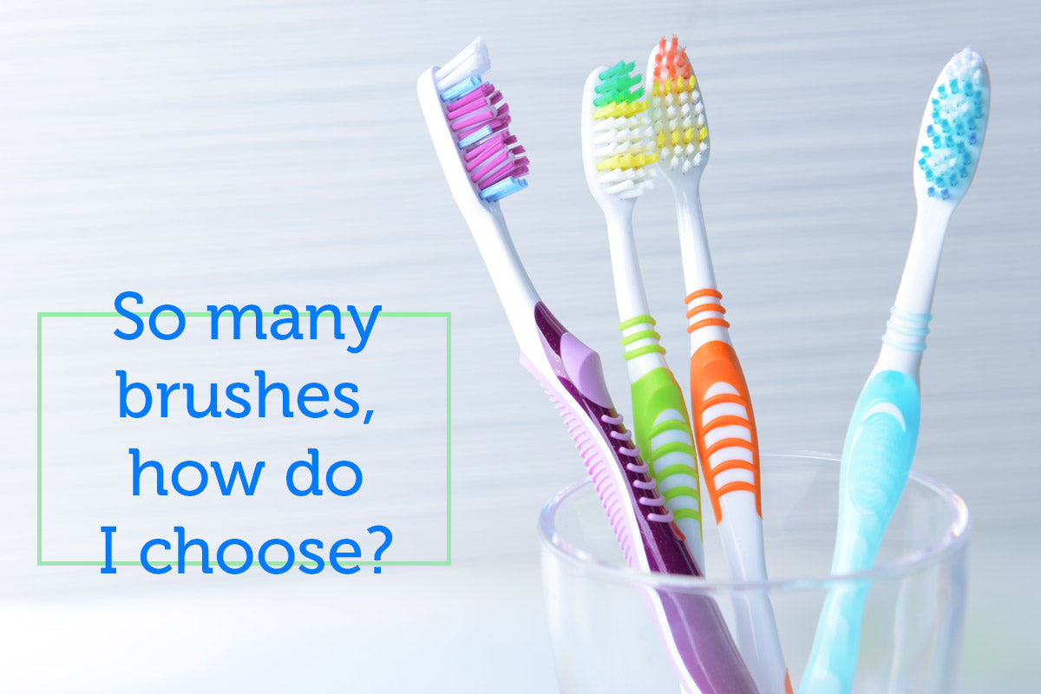
Choosing Right toothbrush and toothpaste
Opt for a toothbrush with soft bristles to avoid damaging tooth enamel and gums.
Consider the size and shape of the toothbrush head to ensure it comfortably reaches all areas of the mouth.
Choose a toothbrush with a comfortable handle grip to facilitate proper brushing technique.
40

Slide 41
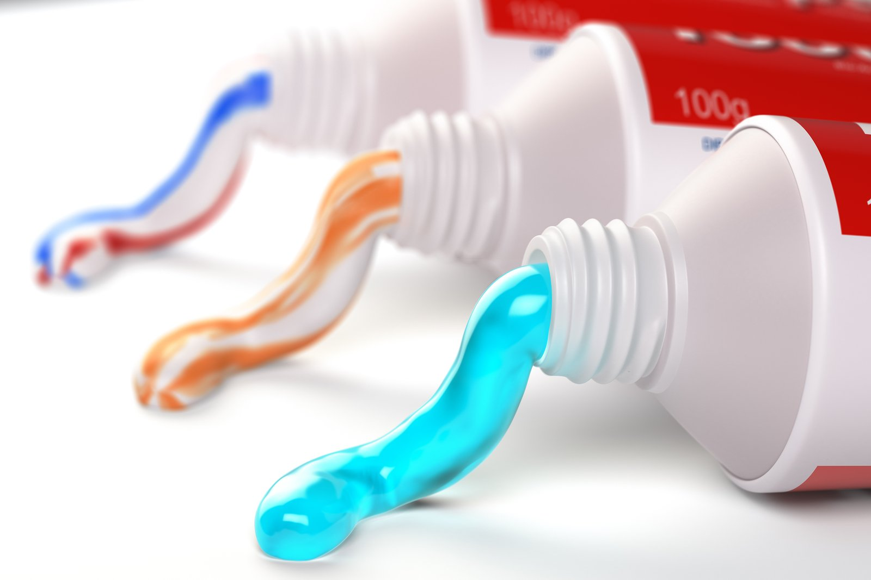
Choosing the Right Toothpaste
Look for toothpaste containing fluoride, a mineral that helps prevent tooth decay by strengthening enamel.
Consider specific dental needs, such as sensitivity or whitening, when selecting toothpaste.
Check for the American Dental Association (ADA) Seal of Acceptance on toothpaste packaging to ensure it meets safety and efficacy standards.
Avoiding Harsh Ingredients:
Toothpaste containing harsh abrasives or whitening agents can damage enamel or irritate gums.
Avoid toothpaste with excessive flavors or additives that may cause allergic reactions or sensitivity.
41

Slide 42
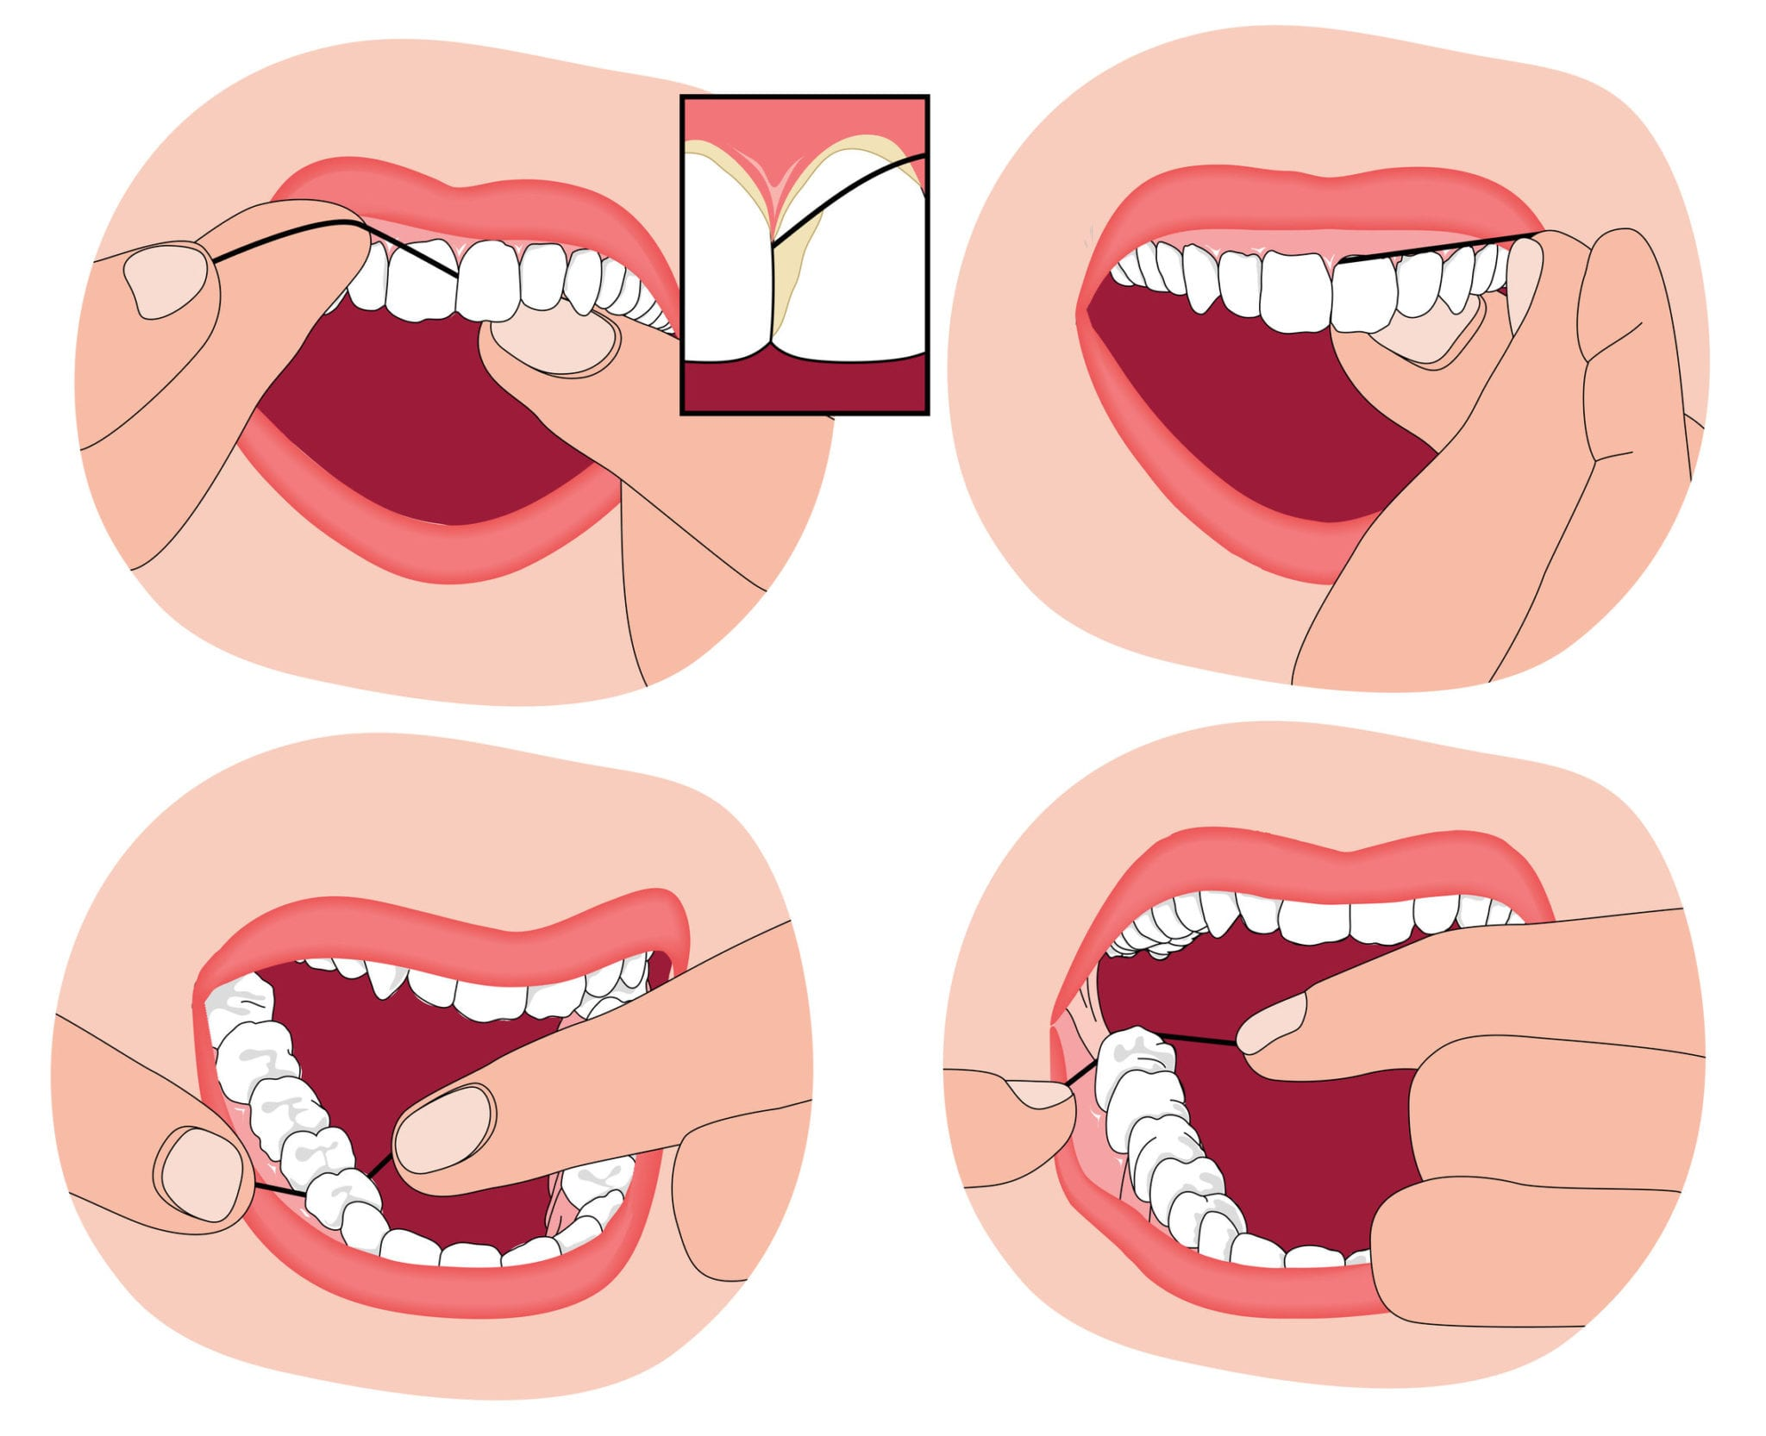
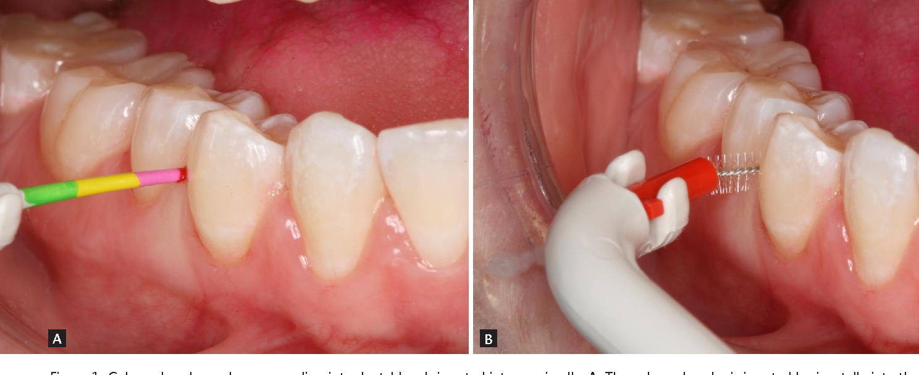
How to floss?
Flossing is a crucial component of a comprehensive oral hygiene routine, playing a significant role in maintaining healthy teeth and gums.
While brushing effectively removes plaque from the surfaces of teeth, flossing targets the areas between teeth and below the gumline, where toothbrush bristles cannot reach
1
2
3
4
42

Slide 43
Fluorides
43

Slide 44
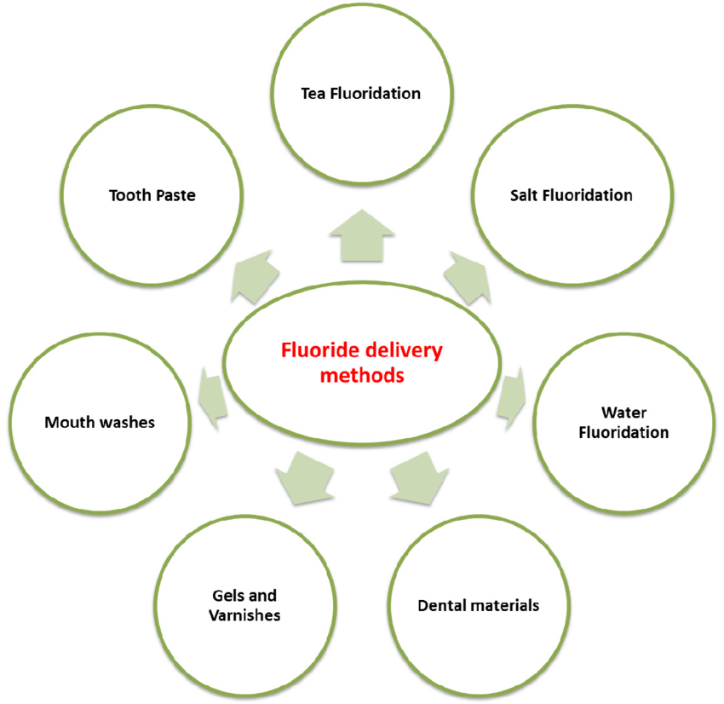
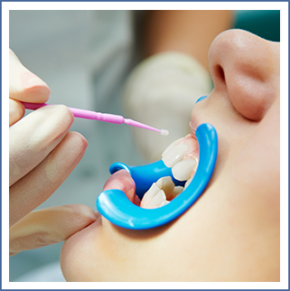
44

Slide 45
Diet and oral health
Nutrient rich foods
Vitamins A, C, D, and calcium
Foods like fruits, vegetables, dairy products, and lean proteins provide these essential nutrients, supporting the development and maintenance of tooth enamel and gum tissue.
45

Slide 46
Impact of sugar and carbohydrates
Limiting the intake of sugary snacks, candies, sodas, and processed foods can help reduce the risk of cavities and maintain optimal oral health.
46

Slide 47
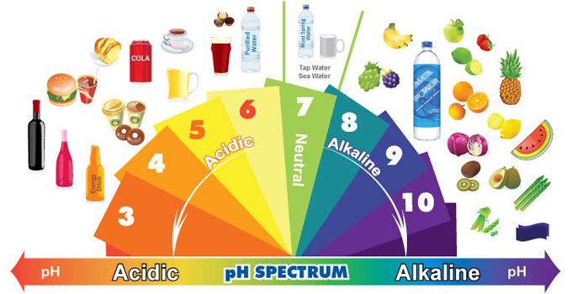
Acidic foods and beverages
Acidic foods and beverages, such as citrus fruits, tomatoes, vinegar-based dressings, and carbonated drinks, can weaken tooth enamel and increase susceptibility to erosion.
47

Slide 48
Importance of hydration
Drinking an adequate amount of water is essential for maintaining oral health.
Water helps rinse away food particles and bacteria, hydrates oral tissues, and stimulates saliva production.
Saliva plays a crucial role in neutralizing acids, remineralizing enamel, and protecting against tooth decay and gum disease.
48

Slide 49
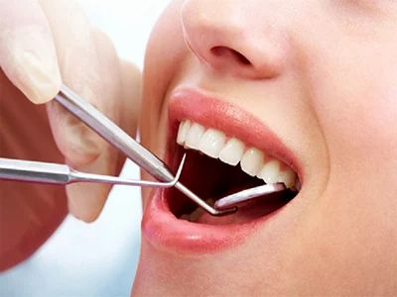
Regular Dental Check-ups
Regular dental check-ups very six months are essential for maintaining optimal oral health.
Dentists can detect early signs of tooth decay, gum disease, and oral cancer during these visits, allowing for timely intervention and treatment.
49

Slide 50
Preventive measures offered by dentist
Good oral hygiene habits
Fluoride application
Oral Prophylaxis / Scaling
Pit and Fissure sealants
Habit Correction
Oral cancer screenings for early detection
50

Slide 51
Role of Dentists
Education and Awareness
Treatment
Support
51

Slide 52
Tobacco and oral health
Increase the risk of oral health problems such as gum disease, tooth decay, oral cancer, and tooth loss.
Smoking and chewing tobacco expose the mouth to harmful chemicals that damage oral tissues and compromise overall oral health.
Quitting tobacco significantly reduces these risks and improves oral health outcomes.
52

Slide 53
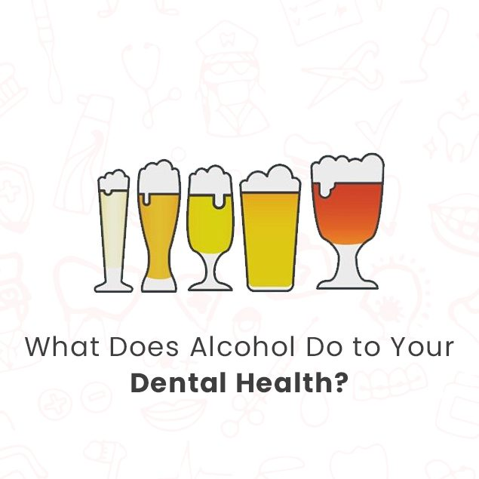
Alcohol and oral health
Excessive alcohol consumption can contribute to oral health issues including dry mouth, gum disease, oral cancer, and tooth decay.
Alcohol's acidic nature can erode tooth enamel, while its drying effect reduces saliva production, leading to increased bacterial growth.
Limiting alcohol intake and practicing good oral hygiene can help mitigate these risks.
53

Slide 54
Take Home Message
Maintain Good Oral Hygiene: Brushing teeth twice daily with fluoride toothpaste and flossing regularly help remove plaque and prevent periodontal disease.
Regular Dental Check-ups: Routine dental visits allow for early detection of oral manifestations of systemic diseases and prompt intervention.
Healthy Lifestyle Habits: Adopting a balanced diet, limiting sugar intake, avoiding tobacco use, and managing stress contribute to overall oral and systemic health.
Collaborative Care: Patients with systemic diseases should receive comprehensive care from a multidisciplinary team, including physicians and dentists, to address oral health needs effectively.
Medication Management: Patients taking medications that affect oral health, such as antiretroviral therapy or medications causing dry mouth, should be monitored closely, and appropriate interventions should be implemented to minimize oral complications.
Patient Education: Educating patients about the importance of oral hygiene, regular dental care, and the potential impact of systemic diseases on oral health empowers them to take proactive steps to maintain oral and overall health.
54

Slide 55
References
World Dental Federation. The Challenge of Oral Disease, a Call for Global Action. The Oral Health Atlas. Second Edition. 2015. Available online: https://www.fdiworlddental.org/sites/default/files/202103/complete_oh_atlas-2_0.pdf (accessed on 15 June 2022).
Menezes, T.; Rodrigues, M.; Nogueira, B.; Menezes, S.; Silva, S.; Vallinoto, A. Oral and systemic manifestations in HIV-1 patients. Rev. Soc. Bras. Med. Trop. 2015, 48, 83–86.
55

Slide 56
Thank You
oral health =
overall health
Prioritize it for a brighter smile
Dr. Shally Mahajan
MDS, Orthodontics and Laser Specialist
Professor and Head, Department of Dentistry
Dr. RMLIMS, Lucknow
56

